Slide 1


Surveillance & Überveillance
School of Business, Law and Entrepreneurship
Online Learning Materiel: Week 4 Presentation 3

Slide 2
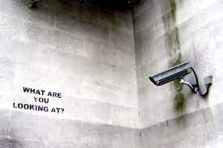

Slide 3
Surveillance defined & Characterised.
“…any systematic, routine, and focused attention to personal details for a given purpose (Lyon 2007); “the deliberate or purposive observation or monitoring of a person, object or place (VLRC 2010)
There are various categories of surveillance, including: optical or visual surveillance, audio surveillance, tracking or location surveillance, physical surveillance and data surveillance.
Common surveillance technologies include: Closed Circuit Television (CCTV), Unmanned Aerial Vehicles, Body Worn Cameras, Communication surveillance (Phones, Google Home, etc.)
The way that surveillance technologies are designed and deployed will determine the effect they have on individuals’ privacy
Notes:
3

Slide 4
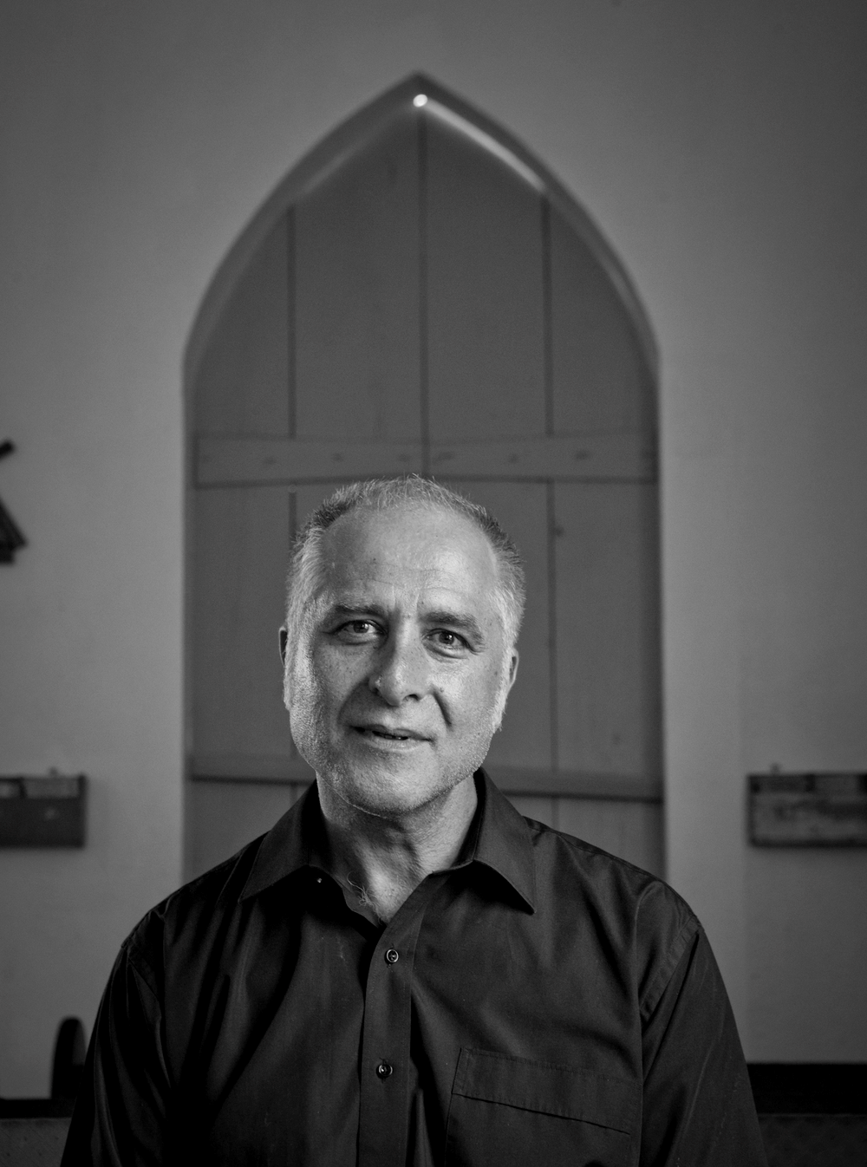
Überveillance Defined & Characterised.
Überveillance (pronounced 'oohbuhvayluhns’) noun. an omnipresent electronic surveillance facilitated by technology that makes it possible to embed surveillance devices in the human body.
A term conceived by Dr. MG Michael and used to describe intensive surveillance processes only developed in the 21st century.
Notes:
4

Slide 5
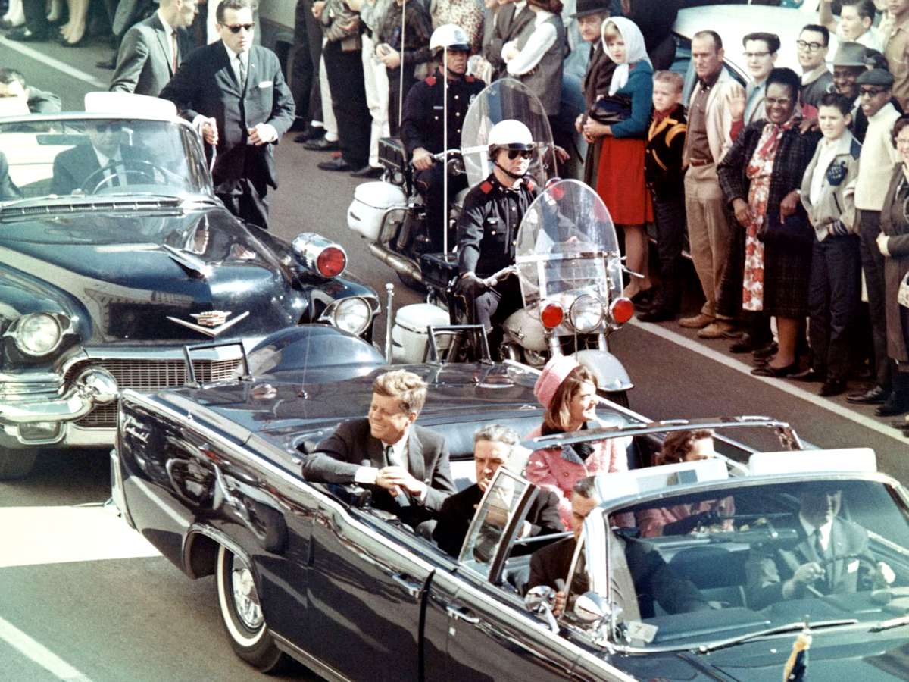
What if Überveillance had been around in the past?
Notes:
5

Slide 6
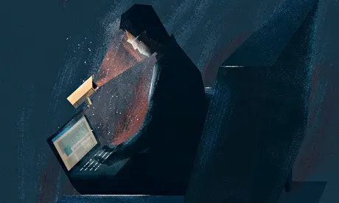

Überveillance makes ‘private space’ obsolete.
Private space is that location which we all need- “saint” and “sinner” alike- to make our mistakes in secret, to mature into wisdom, and to discover what we are and are not capable of.
In losing our privacy, we are also forfeiting a critical component of our personal identity, “the identity of consciousness”.
Notes:
6

Slide 7

When your Uber Eats driver is being Überveilled while collecting your ÜBERBÜRGER order which was grilled for Ü.
Notes:
7

Slide 8
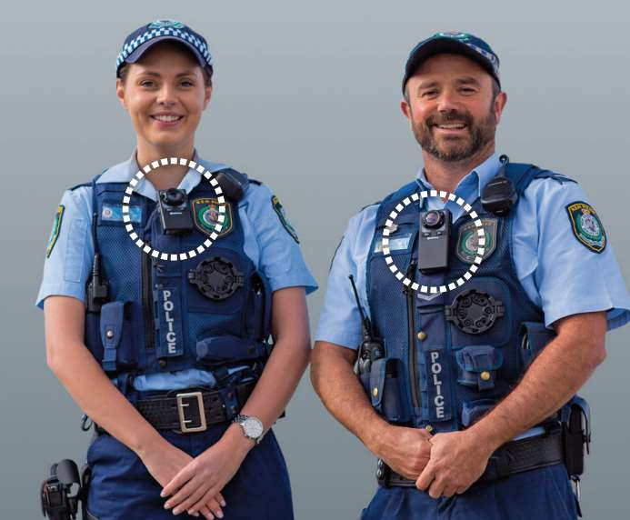
Privacy & Body Worn Cameras.
Knoxville police body cameras record first high-profile case, and authorities sit on video
An amendment to the original funding bill would restrict DPS from releasing the body-cam video unless it depicts a criminal act. Critics say that means no video could be shown of non-criminal activities like traffic stops, questioning of witnesses, car crashes, and even alleged trooper misconduct.
Notes:
8

Slide 9
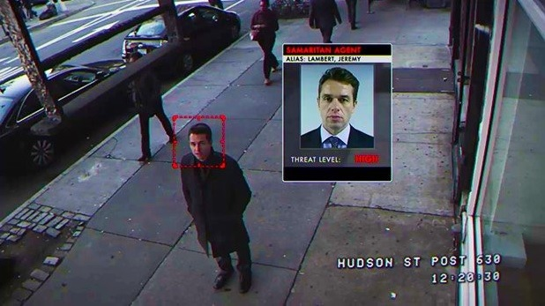
Privacy & Surveillance.

Slide 10


